Slide 1
Probability
Random experiment, Sample space

Slide 2
In the study of statistics, we are concerned basically with the presentation and interpretation of chance outcomes that occur in a planned study or scientific investigation. For example,
we may record the number of accidents that occur monthly at the intersection of 7th ave and Kashmir highway,
hoping to justify the installation of a traffic light;
we might classify items coming off an assembly line as “defective” or “non-defective”;
or
we may be interested in the volume of gas released in a chemical reaction.
Hence, the statistician is often dealing with either numerical data, representing counts or measurements, or categorical data, which can be classified according to some criterion.

Slide 3
We shall refer to any recording of information, whether it be numerical or categorical, as an observation.
Thus,
the numbers 2, 0, 1, and 2, representing the number of accidents that occurred for each month from January through April during the past year at the intersection of 7th ave and Kashmir highway, constitute a set of observations.
Similarly, the categorical data N, D, N, N, and D, representing the items found to be defective or non-defective when five items are inspected, are recorded as observations.

Slide 4
Statisticians use the word experiment to describe any process that generates a set of data.
A simple example of a statistical experiment is the tossing of a coin. In this experiment, there are only two possible outcomes, heads or tails.
Another experiment might be the launching of a missile and observing of its velocity at specified times.
The opinions of voters concerning a new sales tax can also be considered as observations of an experiment.
We are particularly interested in the observations obtained by repeating the experiment several times. In most cases, the outcomes will depend on chance and, therefore, cannot be predicted with certainty.
If a chemist runs an analysis several times under the same conditions, he or she will obtain different measurements, indicating an element of chance in the experimental procedure.
Even when a coin is tossed repeatedly, we cannot be certain that a given toss will result in a head. However, we know the entire set of possibilities for each toss.

Slide 5
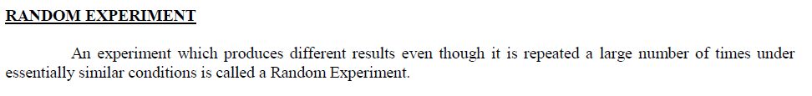
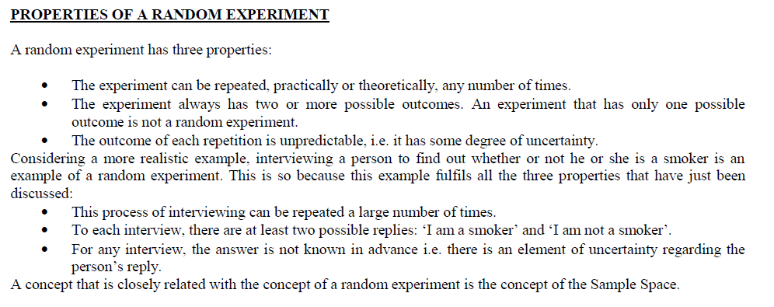

Slide 6
Definition 2.1:
The set of all possible outcomes of a statistical experiment is called the sample space and is represented by the symbol S.
Each outcome in a sample space is called an element or a member of the sample space, or simply a sample point.
If the sample space has a finite number of elements, we may list the members separated by commas and enclosed in braces.
Thus, the sample space S, of possible outcomes when a coin is flipped, may be written S = {H, T},
where H and T correspond to heads and tails, respectively

Slide 7
Example 2.1: Consider the experiment of tossing a die. If we are interested in the number that shows on the top face, the sample space is S1 = {1, 2, 3, 4, 5, 6}. If we are interested only in whether the number is even or odd, the sample space is simply S2 = {even, odd}.

Slide 8
In general, it is desirable to use the sample space that gives the most information concerning the outcomes of the experiment.
In some experiments, it is helpful to list the elements of the sample space systematically by means of a tree diagram

Slide 9
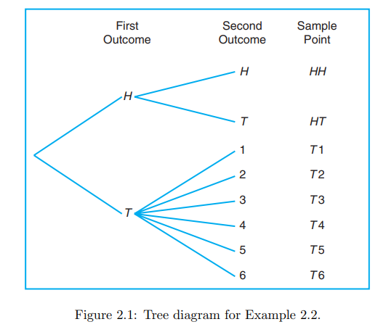
Example 2.2: An experiment consists of flipping a coin and then flipping it a second time if a head occurs. If a tail occurs on the first flip, then a die is tossed once. To list the elements of the sample space providing the most information, we construct the tree diagram
By proceeding along all paths, we see that the sample space is
S = {HH, HT, T1, T2, T3, T4, T5, T6}.

Slide 10
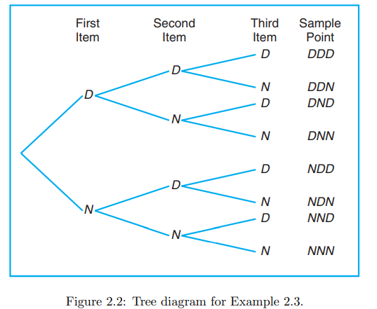
Example 2.3: Suppose that three items are selected at random from a manufacturing process. Each item is inspected and classified defective, D, or non-defective, N. To list the elements of the sample space providing the most information, we construct the tree diagram
the sample space is
S = {DDD, DDN, DND, DNN, NDD, NDN, NND, NNN}.

Slide 11
Sample spaces with a large or infinite number of sample points are best described by a statement or rule method.
For example, if the possible outcomes of an experiment are the set of cities in the world with a population over 1 million, our sample space is written
S = {x | x is a city with a population over 1 million},
which reads “S is the set of all x such that x is a city with a population over 1 million.”
The vertical bar is read “such that.”
Similarly, if S is the set of all points (x, y) on the boundary or the interior of a circle of radius 2 with center at the origin, we write the rule
S = {(x, y) | x2 + y2 ≤ 4}

